Slide 1
Joint CIO – CSSAA – CCCAOE– ASCCC
Regional Meeting
Los Angeles and Orange County
April 21, 2016

Slide 2
Sacramento Joint Meeting

Slide 3
Overview For This Morning
How can we best implement the 25 Strong Workforce Recommendations and the new budget authorization of $200 Million?
How can our organizations and our colleges best adapt to the new challenges that require heightened collaboration regionally?

Slide 4
Regions: How To Align Them?
Does “align” mean “adopt one model”? or, can there be other approaches?
WIOA (Federal): 14 Planning Units
California: 7 Regions
CCCAOE: 7 Regions
CCCCIO: 10 Regions
CCCSSAA: 10 Regions
ASCCC: 4 Area Reps + 6 Other Reps

Slide 5
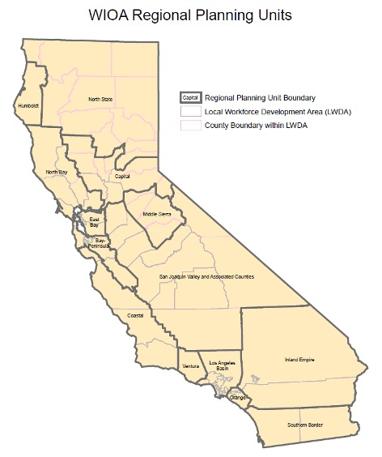
Workforce Development Boards
14

Slide 6
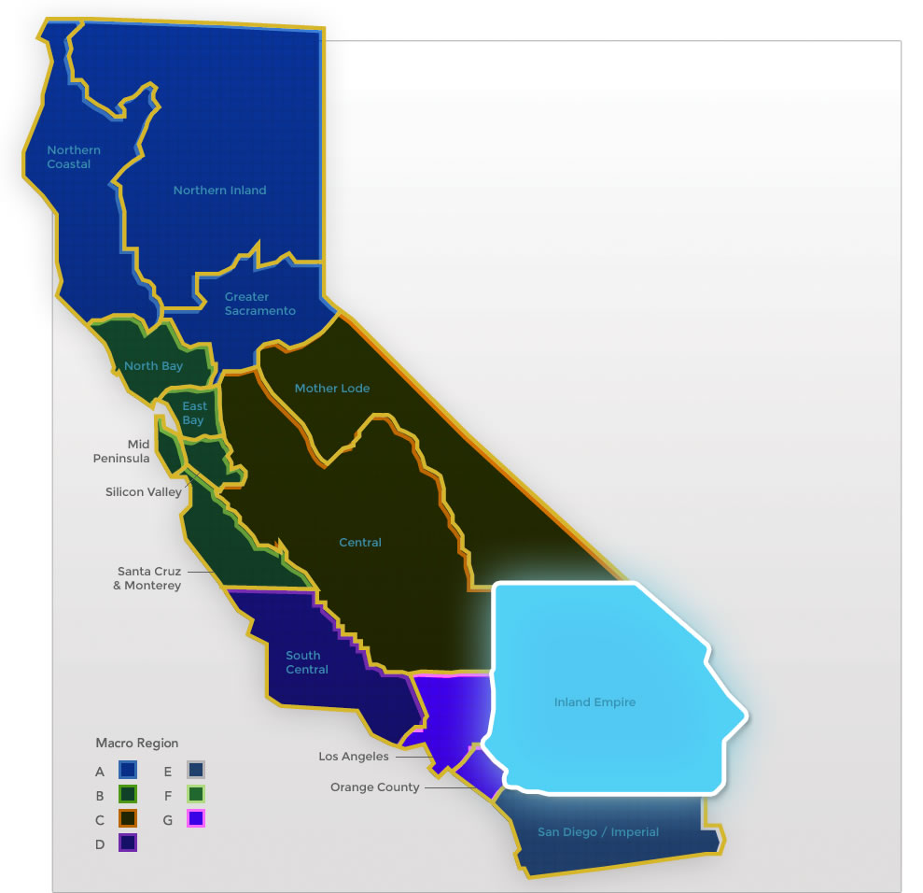
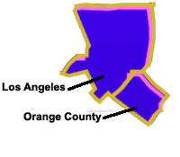
Doing What Matters – 7 Regions

Slide 7
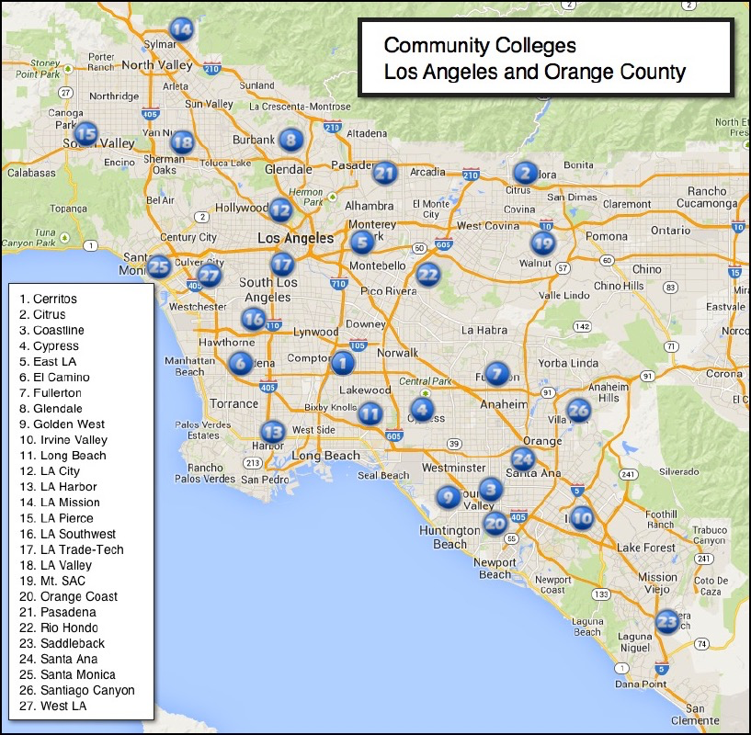
Los Angeles-Orange County Regional Consortia
27
Community
Colleges

Slide 8
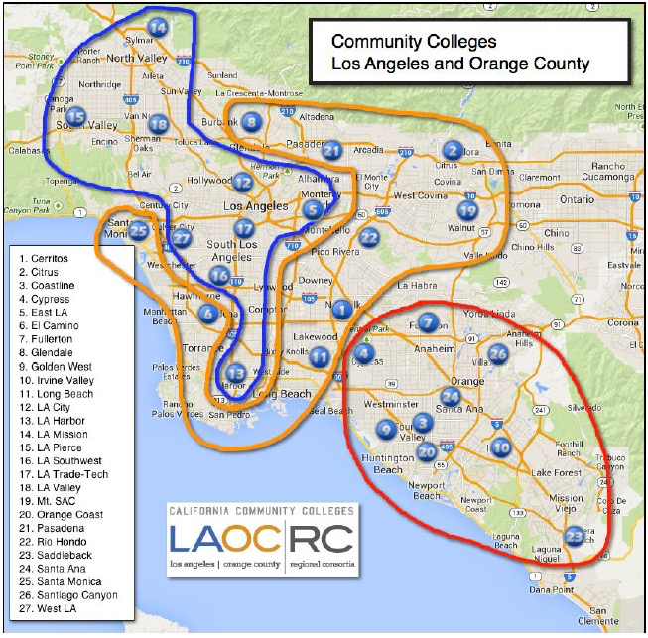
LACCD
Ring
OC

Slide 9
CCCAOE Regions & Colleges (7)

Slide 10
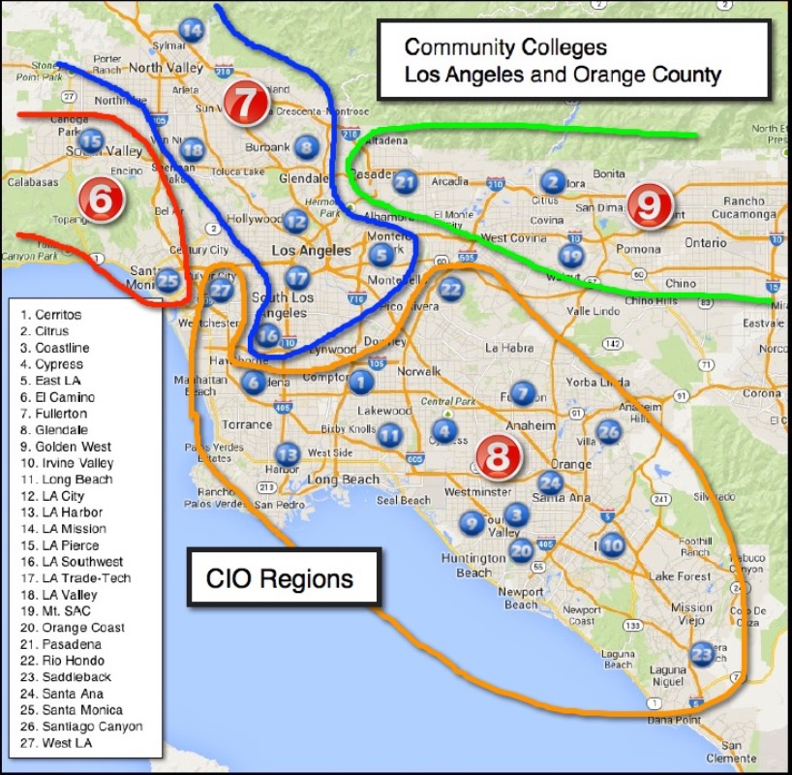
CIO
4
Regions

Slide 11
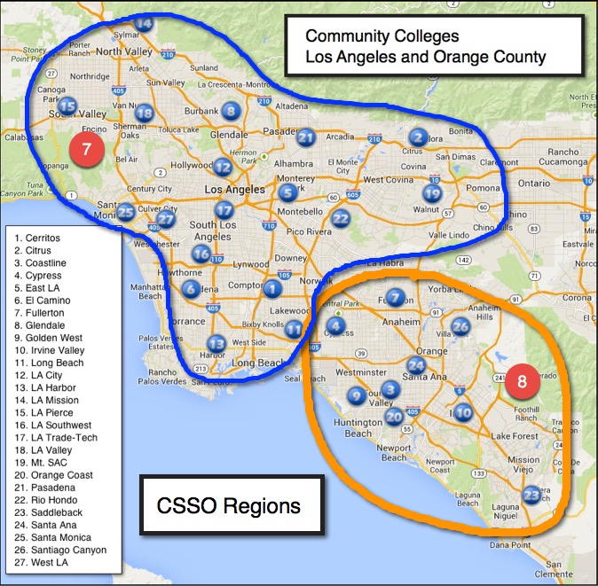
CSSAA
2
Regions

Slide 12
ASCCC
4 Area
Reps +
6 Others

Slide 14
Student Success & Support Programs – Strategic Goals
Provide assistance in admissions, orientation, assessment and testing, counseling, and student follow-up to:
Ensure that all students complete their college courses
Persist to the next academic term
Achieve their educational objectives

Slide 15
Student Equity Planning – Strategic Goals
Improve student outcomes measured by success indicators
“Success indicators” identify and measure areas for which disadvantaged populations may be impacted by issues of equal opportunity
Populations to be examined for disproportionate impact:
American Indians or Alaskan natives, Asians or Pacific Islanders, Blacks, Hispanics, Whites, men, women, and persons with disabilities (Title 5; 54220(d).
foster youth, veterans and low income students (SB 860)

Slide 16
Basic Skills Initiative – Strategic Goals
To maximize the effectiveness and efficient utilization of the system's Basic Skills and ESL resources
To identify, promote, and disseminate information on exemplary programs and effective practices
To achieve program improvements through their replication and adaptation to the unique characteristics of individual community colleges/districts
To recognize and inform the public about the system's achievement on the basic skills mission and outcome data

Slide 17
6 Key
Questions

Slide 18
Discussion QUESTIONS
Are we organized to respond as a region to new initiatives?
What is our regional collaborative and communication structure?
How are we leveraging the data and resources to build regional infrastructure?
How are we collaborating on SSSP, Equity, Basic Skill Initiative, and Doing What Matters?
What opportunities exist for the CIO, CSSSO, Faculty, and CCCAOE to collaborate?
What are major challenges to requests and initiatives?

Slide 19
QUESTION 1
How are we organized as a region to respond to new initiatives? (15 Minutes)
· What happens when a regionally directed RFP surfaces? Can each college in your region articulate that process?
· How often do Instructional and Student Services VPs meet individually and collectively? Are CTE or other Deans included?

Slide 20
QUESTION 2
What is our regional collaborative and communication structure? (15 Minutes)
· What communication structures are in place for collaborative sharing in your region?
· How is this communication structure maintained?
· If you do not have a communication structure, please take 5 minutes to brainstorm ideas before moving to next questions.

Slide 21
QUESTION 3
How are we leveraging the data and resources to build regional infrastructure? (15 minutes)
· How does your region share data? How is this maintained?
· What data are needed?
· What is the vision for Data Unlocked?

Slide 22
QUESTION 4 (1 of 2)
How are we collaborating on SSSP, Equity, Basic Skill Initiative, and Doing What Matters? (15 Minutes)
· How are SSSP, Equity, and BSI organized and delivered on your campuses (please respond by college)?
· What innovations have been piloted within your region for leveraging any of the resources from these initiatives collaboratively?

Slide 23
QUESTION 4 (2 of 2)
· Will your region respond to the regional BSI RFA? If yes, what challenges has your region faced this process? If no, what challenges have prevented your region from considering a proposal?
· How does your DWM team connect to the CIOs and CSSOs in your region? As a CSSO or CIO, do you feel adequately informed and engaged?

Slide 24
QUESTION 5
What opportunities exist for the CIO, CSSSO, and CCCAOE to collaborate ? (15 Minutes)
· Please share best practices that your region is employing to maintain a culture of collaboration
· Please take the next 5 minutes to brainstorm ideas for extending collaboration across instruction, student services, and CTE.

Slide 25
QUESTION 6
What are the major challenges to responding to requests and managing multiple initiatives on your campus and from a regional perspective and what suggestions might you offer to the CCCCO moving forward? (15 Minutes)
For this discussion, consider:
· Requests for proposals
· Reports Submission
· Budgetary considerations

Slide 26
OPEN DISCUSSION
(15 Minutes)

Slide 27
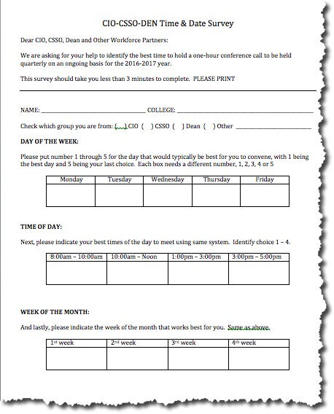
Survey – Quarterly Webinar/Engagement
Please
Complete

Slide 28
Announcements

